Slide 1
HEALTH INSURANCE ANALYSIS
Analyzed by:
Group - Hamster
Meru Bhatnagar
Jayendra Bhardwaj
Aman Mahajan
Shubham Mittal
Presented to:
Dr. Douglas Jones
Presented on:
Dec 4, 2017
Course Name : Data Analysis and Decision Making
Course Period : Sep 2017 – Dec 2017

Slide 2
PROBLEM STATEMENT
Our analysis is focussed on the problem which insurance providers are facing today to define their target market and plan their sale strategies which helps them increase their market share and thereby, maximize their profitability.
OBJECTIVE
By analyzing this data frame containing 8,802 observations on 11 variables namely Health, Age, Limit, Gender, Insurance etc., we predict which are the customers who are more likely to buy insurance based on different parameters.
On analysis of "Cross-section Data Originating From the Medical Expenditure Panel Survey" the insurers are enabled to frame their business plan and target market effectively.

Slide 3
MODEL
As mentioned in the previous slide, our response will be categorical i.e. “If the respondent is having insurance”.
Therefore, we have conducted our analysis using Generalized Linear Model (GLM).
VARIABLES
1) Health -> Factor -> Is the self-reported health status “healthy”? | 2) Age -> Age of respondent in Years
3) Limit -> Factor -> Is there any limitation? | 4) Gender -> Factor -> Indicating the gender
5) Insurance -> Factor -> Does the individual have a health insurance? | 6) Married ->Factor ->Is the individual married?
7) Selfemp -> Factor -> Is the individual self-employed? | 8) Family -> Indicates family size.
9) Region -> Factor -> Indicating region. | 10) Ethnicity -> Factor -> Indicating ethnicity: African-American, Caucasian, other.
11) Education -> Factor -> Indicating highest degree attained: no degree, GED (high school equivalent), high school, bachelor, master, PhD, other.

Slide 4
CONCLUSION
Our analysis can be used by insurance providers to predict whether the respondent has insurance or not.
The person who is married has more probability of having Health Insurance.
The probability of having Health Insurance increases with increase in Age of a person.
An educated person is more likely to have insurance with him or her.
Gender is significant but since the p value of age and marital status is less than that of gender so we can assume that gender(Male and Female) won’t be that significant to predict the insurance response.
After performing chi square and hypothesis testing we can infer that Limit variable is insignificant to tell whether the person has insurance or not.
Levels of significance
We have used hypothesis testing for Stepwise Regression to check the significance of the model.
We have validated the significance of this model for 95% and 5% confidence interval using partial F test and found out that the model is a good fit for all the confidence intervals.

Slide 5
SOFTWARE USED FOR ANALYSIS OF OUR DATA
RStudio (Version 1.0.153)
SOFTWARE USED FOR PRESENTATION
Microsoft Powerpoint 2010
INSTALLED PACKAGES
library(e1071) #Package for Skewness function used for data analysis
library(stats) #Package for finding cook's distance
library(ggplot2) #Package for visualisation of data
library(Amelia) #package to visually display the missing values
library(gridExtra) #Package for arranging different plots in a single grid
library(caTools) #Package for validation of models
library(pscl) #Package for Mc-Fadden R Test
library(ROCR) #Package for ROC graphs

Slide 6
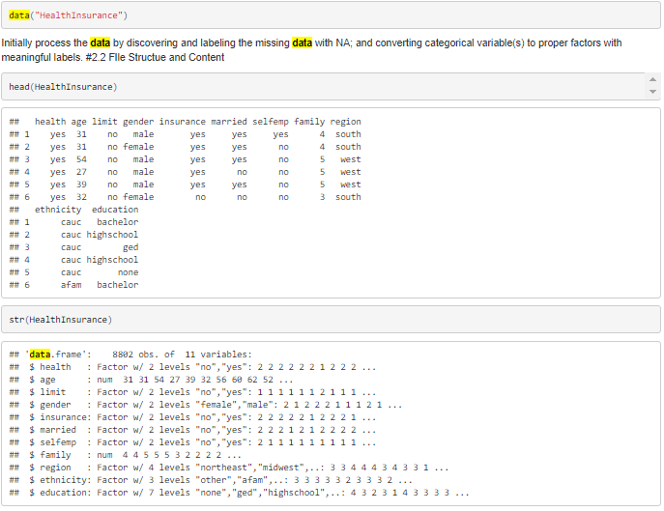
DATA ANALYSIS PROCEDURE
DATA PREPROCESSING
(a)Quality of Data

Slide 7
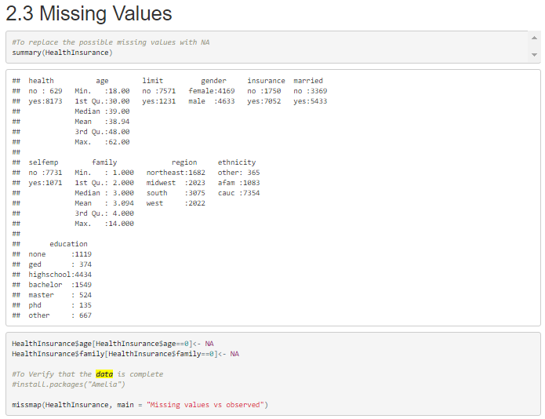

Slide 8
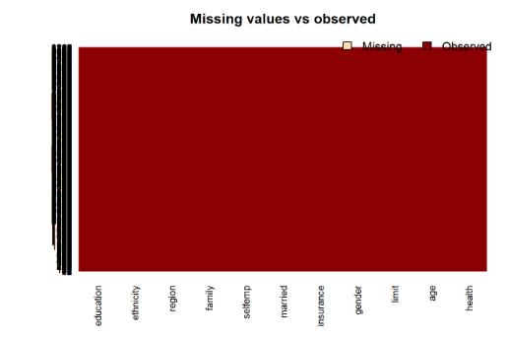
This shows that the data had no missing values.

Slide 9
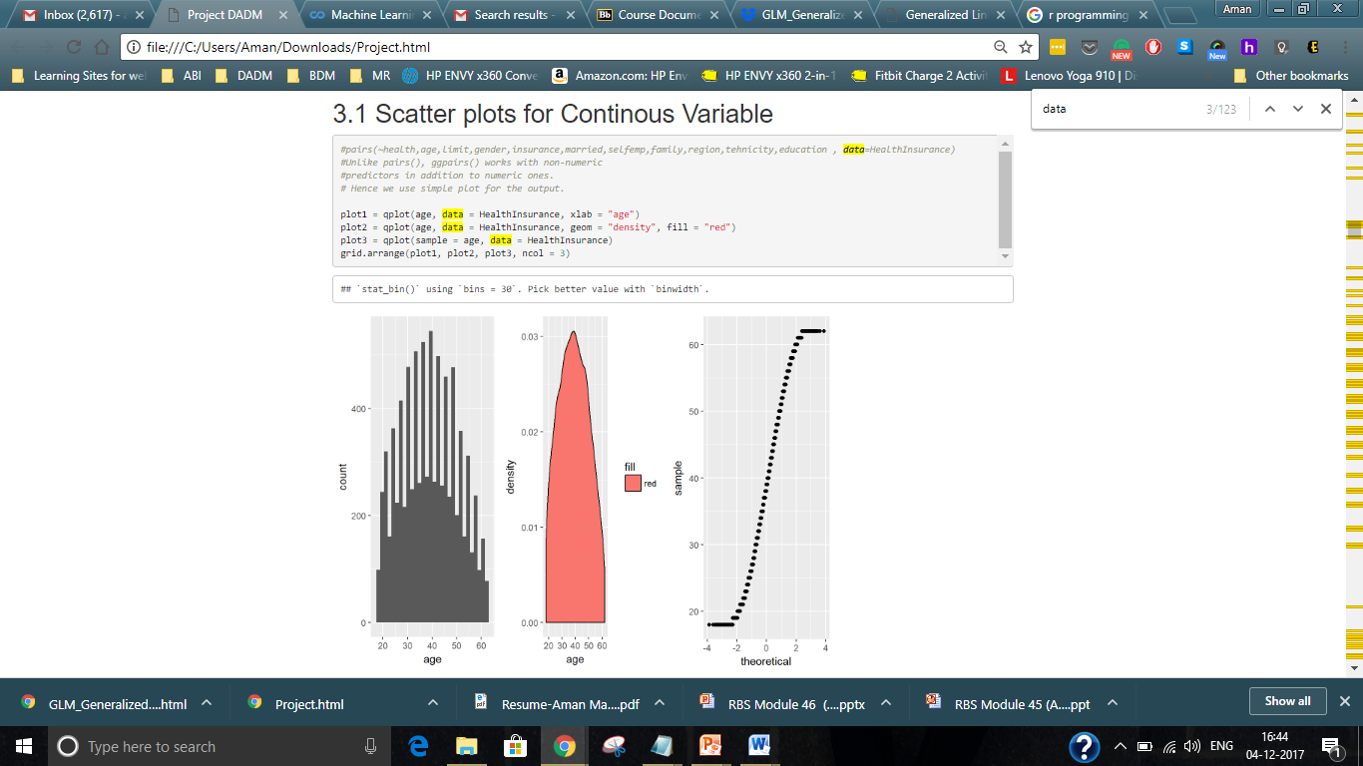
DATA VISUALIZATION
Scatter plots for continuous variables
On observing the density plot graph , we can conclude that variable age is normally distributed and not skewed as the normal distribution graph is neither left nor right skewed.
Since the variable is not skewed so we need not use any transformations like log or sqrt to make age variable normally distributed.

Slide 10
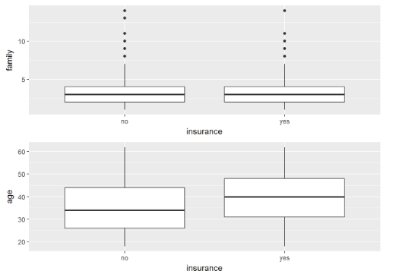
DATA VISUALIZATION
Boxplots
Visual Inspection between the 2 continuous variables: Family Vs insurance box plot tells us that there is considerable amount of potential outliers for family variable

Slide 11
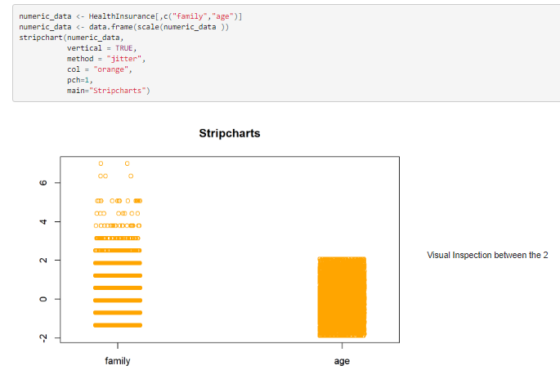

Slide 12
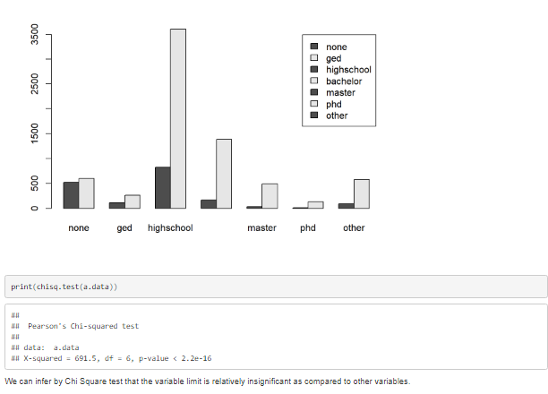
Chi-Square Test of Independence

Slide 13
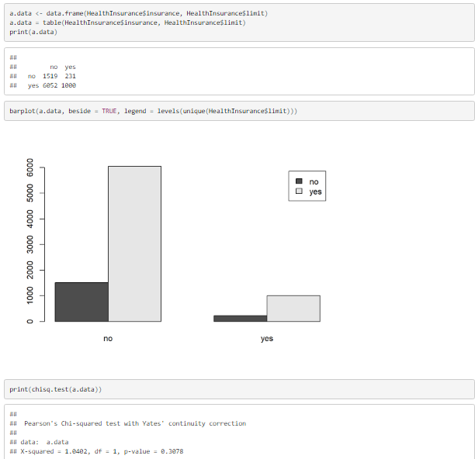

Slide 14
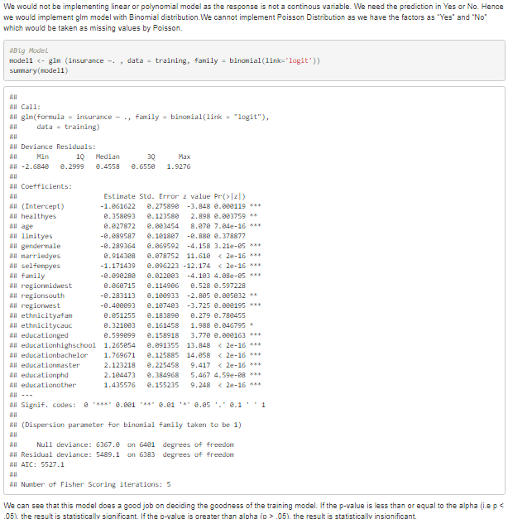
MODEL FIT
Explanation of Model

Slide 15
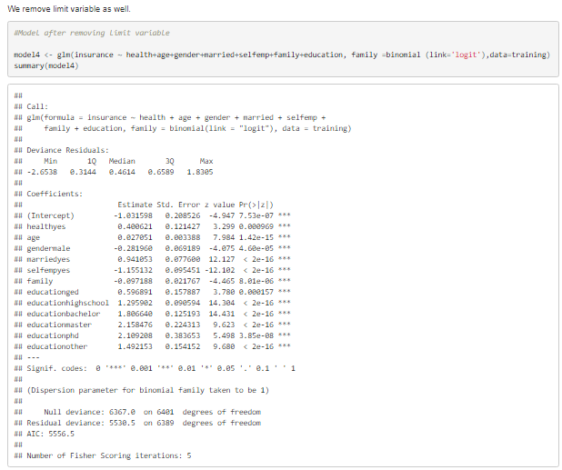
Hypothesis Testing for Stepwise Regression
We can see that all the variables are significant now so model 4 is the potential model to predict the response

Slide 16
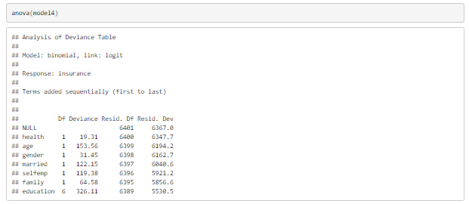
Partial F-test for Confidence Intervals
For Alpha=.05 We find the 95% probable interval from the 00 and 0.95 quartiles of the F distribution for (6388,6401) degree of freedom for model 4

Slide 17
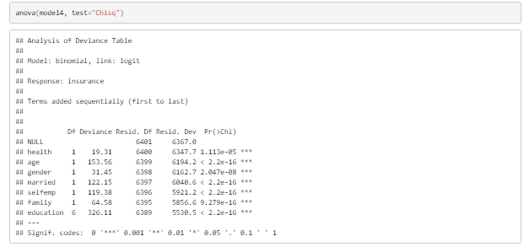
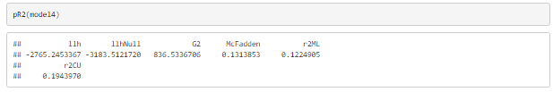
Test for Validating Models Significance
The difference between the null deviance and the residual deviance shows significant model4 is doing against the null model (a model with only the intercept).
The wider this gap, the better which is the max for model 4.
Analysing the table we can see the increase in deviance when removing each variable one at a time.
We can see that it is a significant increase in deviance and the AIC as we go from model 1 to model 4. While no exact equivalent to the R2 of linear regression exists, the McFadden R2 index can be used to assess the model fit which is most for model 4.

Slide 18
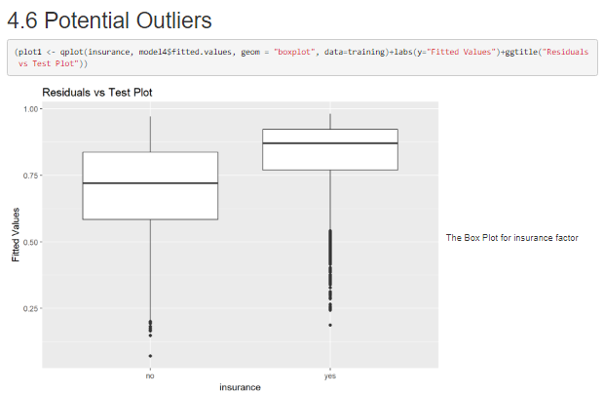
The Box Plot for insurance factor variable reveals a lot of outliers.

Slide 19
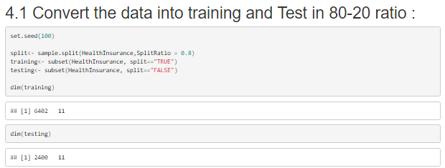
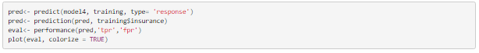
Assessing the predictive ability of the model
To assess the predictive ability of the model, we use ROC curve and calculate the AUC (Area under curve which are typical performance measurements for binary classifier)

Slide 20
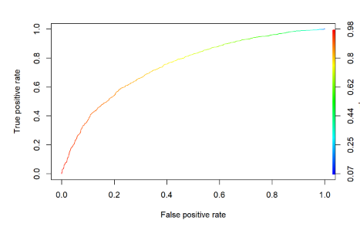
ROC CURVE
The ROC is a curve generated by plotting the true positive rate (TPR) against the false positive rate (FPR) at various threshold settings while the AUC is the area under the ROC curve.

Slide 21
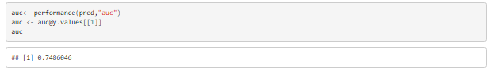
AREA UNDER CURVE
As a rule of thumb, a model with good predictive ability should have an AUC closer to 1 (1 is ideal) than to 0.5 which is the case with model 4 having area under the curve as 0.7486046.

Slide 22
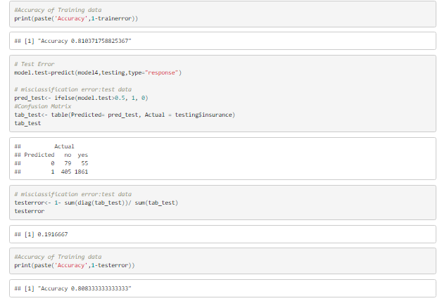
TRAINING AND TESTING ERROR RATE
The error rate for training is roughly 19% and accuracy is 81.03% which is very high compared to real time predictions.
After fitting the model with the testing data we can observe that the accuracy is 80.833 % which indicates satisfactory goodness of fit of the model.

Slide 23
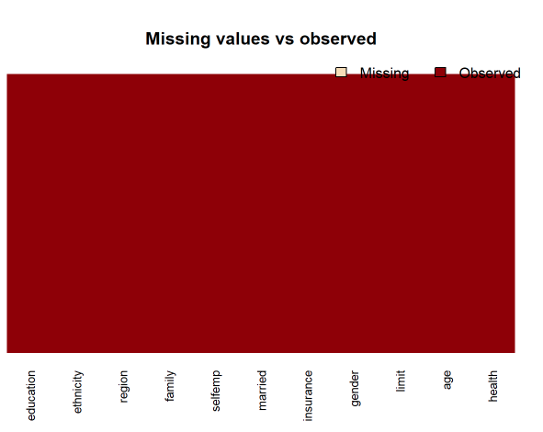
RESULTS
All data is organized in a clear manner with no missing or negative values. We have verified the same by visualizing missing value as shown in the graph.

Slide 24
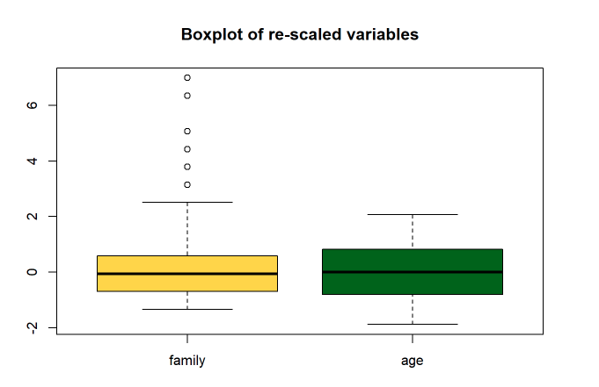
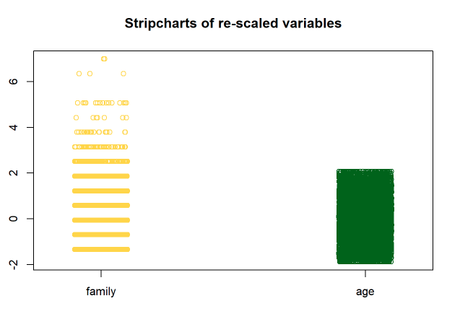
RESULTS(contd..)
Proper box plot and strip charts for z-score scaling are displayed for exploratory data analysis of both continuous and categorical variable. We could identify the potential outliers more efficiently once the mean becomes 0.

Slide 25
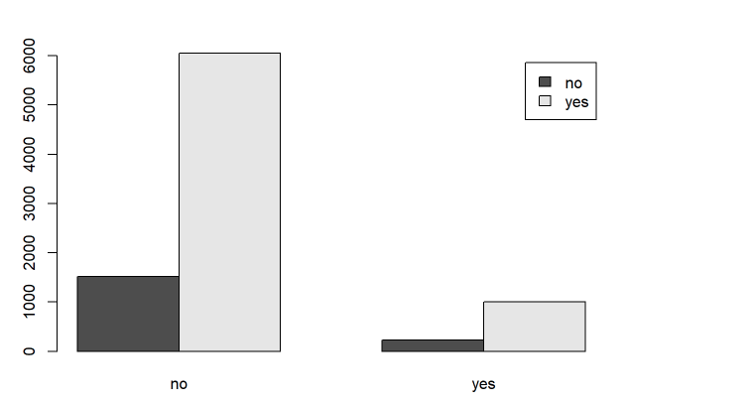
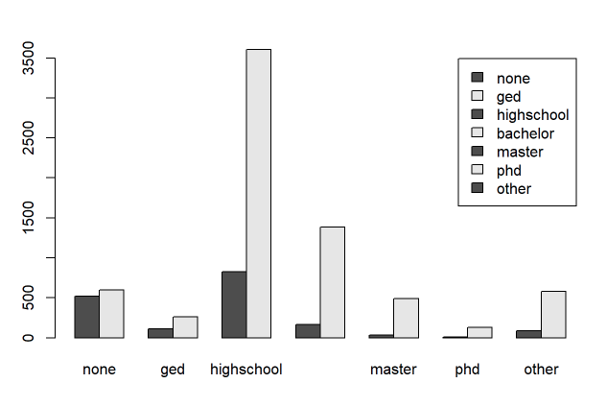
RESULTS(contd..)
Chi Square Test of independence is implemented to tell whether the relation between two categorical variables is significant or not. It was observed that limit variable is insignificant for predicting the insurance response.

Slide 26
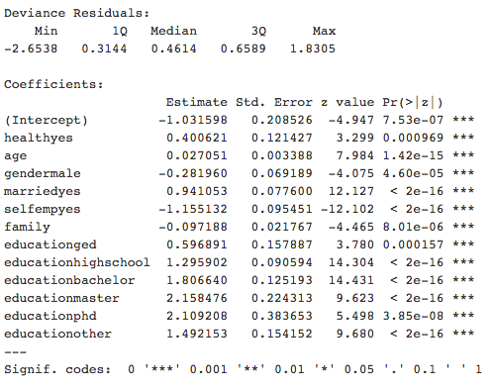
RESULTS(contd..)
Implemented stepwise logistic regression GLM model so that all the variable in the model are highly significant having p-values less than .05. We created model 4 which are having all the significant variables ignoring limit , ethnicity and region variables.

Slide 27
RESULTS(contd..)
Validated the result using ANOVA and McFadden test. We came to the conclusion that model 4 is a good fit to predict the insurance response.
Partial F-Test was done to see that the the model is significant across 95% and 5% confidence intervals.
Training error rate comes out to be roughly 19% while the test error rate is 19.1%. It is safe to infer that the accuracy of both the testing and training dataset is high which indicates satisfactory goodness of fit of the model.
The Area under curve comes out to be 0.7486046 which is closer to 1 (1 is ideal) than to 0.5 thus confirming that the model has good predcitive ability.
Used model 4 for testing dataset and observed the actual movement(health = yes ,age=20, family=3 ,gender=female, education=bachelor, married=yes, selfemp=no) of the response where we got the prediction that there is 91% probabilty that the person has insurance.

Slide 28
Conclusion
After implementing the GLM model (model 4) we can conclude that this model has the highest accuarcy as compared to the big model with all the predictors. We have also validated this using McFadden and ANOVA test.
The model still has lots of potential outliers for the range of 0-.5 which for the fitted values . This means that if the prediction of insurance is less than .5 then there is a very high probabilty that prediction is incorrect.
This feature can be widely used by the insurance companies to predict whether the customer has health insurance or not. This would in turn help to infer the potential insurance buyers and help the companies to target the right audience to get maximum health insurance sales.

Slide 29
THANK YOU!

